Slide 1
Distributed computing

Slide 2
Distributed computing divides a single task between multiple computers.
Each computer can communicate with others via the network.
All computers work together to achieve a common goal. Thus, they all work as a single entity.
A computer in the distributed system is a node while a collection of nodes is a cluster.

Slide 3
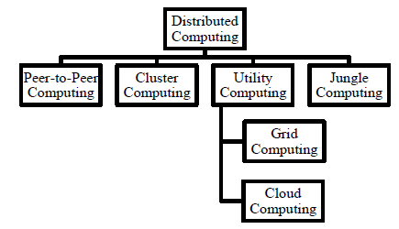
Fig 1: classification of distributed computing

Slide 4
Peer-to-Peer Computing
In a P2P system, every node acts as both a client and a server.
Peer machines are simply client computers connected to the Internet
All client machines act autonomously to join or leave the system freely.
This implies that no master-slave relationship exists among the peers.
No central coordination or no central database is needed.
In other words, no peer machine has a global view of the entire P2P system.

Slide 5
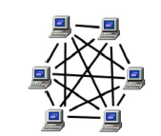
Fig 2: Peer to Peer Network

Slide 6
Cluster Computing
Its a set of independent or stand-alone computers and a network interconnecting them.
It works cooperatively together as a single integrated computing resource.
A cluster is local in that all of its component subsystems are supervised within a single administrative domain, usually residing in a single room and managed as a single computer system.
Here the components are connected to each other through fast local area networks.
It can handle heavy workload with large datasets

Slide 7
Utility Computing
Its analogy is derived from the real world where service providers maintain and supply utility services, such as electrical power, gas, and water to consumers.
Consumers in turn pay service providers based on their usage.
Therefore, the underlying design of utility computing is based on a service provisioning model,
where users (consumers) pay providers for using computing power only when they need to.
Utility computing focuses on a business model, by which customers receive computing resources from a paid service provider.
All grid/cloud platforms are regarded as utility service providers

Slide 8
Grid Computing
Grid Computing can be defined as a network of computers working together to perform a task that would rather be difficult for a single machine.
All machines on that network work under the same protocol to act as a virtual supercomputer.
The task that they work on may include analyzing huge datasets or simulating situations that require high computing power.
Computers on the network contribute resources like processing power and storage capacity to the network
Grid is often constructed across LAN, WAN, or Internet backbone networks at regional, national, or global scales.

Slide 9
Enterprises or organizations present grids as integrated computing resources.
They can be viewed as virtual platforms to support virtual organizations.
The computers used in a grid are primarily workstations, servers, clusters, and supercomputers.
The grids can be of many types as; Knowledge, Data, Computational, Application Service Provisioning, Interaction or Utility

Slide 10
A Grid computing network mainly consists of these three types of machines
Control Node: A computer, usually a server or a group of servers which administrates the whole network and keeps the account of the resources in the network pool.
Provider: The computer contributes its resources to the network resource pool.
User: The computer that uses the resources on the network.

Slide 11
Advantages:
These are capable to solve larger, more complex problems in a shorter time,
these are easier to collaborate with other organizations,
these make better use of existing hardware

Slide 12
Disadvantages:
The software of the grid is still in the involution stage.
A super fast interconnect between computer resources is the need of hour.
Licensing across many servers may make it prohibitive for some applications.
Many groups are reluctant with sharing resources

Slide 13
Cloud Computing
Cloud computing is the on-demand delivery of IT resources over the Internet with pay-as-you-go pricing.
Instead of buying, owning, and maintaining physical data centers and servers, you can access technology services, such as computing power, storage, and databases, on an as-needed basis from a cloud provider like Amazon Web Services (AWS).

Slide 14
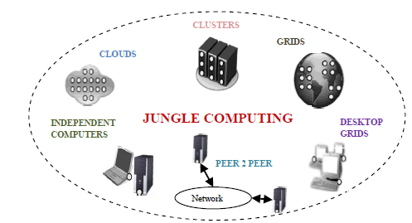
Jungle Computing

